Slide 1
Priority Queues

Slide 2
Outline
Priority Queue
Simple Implementation
Binary Heap
Applications

Slide 3
Priority Queue
A priority queue is an abstract data type which is like a regular queue or stack data structure, but where additionally each element has a "priority" associated with it.
An element with high priority is served before an element with low priority. If two elements have the same priority, they are served according to their order in the queue.
A priority queue must at least support the following operations:
insert_with_priority: add an element to the queue with an associated priority.
pull_highest_priority_element: remove the element from the queue that has the highest priority, and return it.
This is also known as "pop_element(Off)", "get_maximum_element" or "get_front(most)_element".
Typically implemented with a Binary Heap

Slide 4
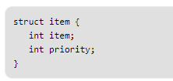
Implementations
A simple implementation is to use array of following structure.
insert() operation can be implemented by adding an item at end of array in O(1) time.
getHighestPriority() operation can be implemented by linearly searching the highest priority item in array. This operation takes O(n) time. Also known as Peek.
deleteHighestPriority() operation can be implemented by first linearly searching an item, then removing the item by moving all subsequent items one position back.
Linked List can also be used, time complexity of all operations with linked list remains same as array. The advantage with linked list is deleteHighestPriority() can be more efficient as we don’t have to move items.

Slide 5
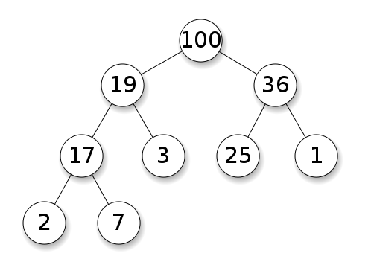
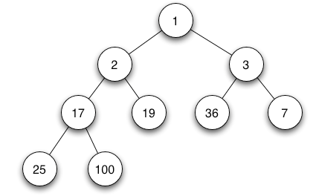
Binary Heap
A Binary Heap is a Binary Tree with following properties.
A complete binary tree; that is, all levels of the tree, except possibly the last one (deepest) are fully filled, and, if the last level of the tree is not complete, the nodes of that level are filled from left to right.
A Binary Heap is either Min Heap or Max Heap. In a Min Binary Heap, the key at root must be minimum among all keys present in Binary Heap. The same property must be recursively true for all nodes in Binary Tree. Max Binary Heap is similar to Min Heap.
Max Heap Min Heap

Slide 6
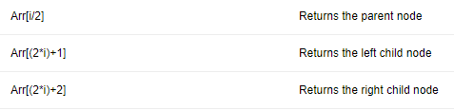
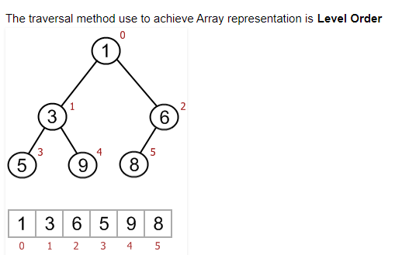
Binary Heap
Array Implementation of a min
The root element will be at Arr[0].
Below table shows indexes of other nodes for the ith node, i.e., Arr[i]:

Slide 7
Binary Heap
Operations on Min Heap:
getMini(): It returns the root element of Min Heap.
extractMin(): Removes the minimum element from Min Heap.
decreaseKey(): Decreases value of key. If the decreased key value of a node is greater than parent of the node, then we don’t need to do anything. Otherwise, we need to traverse up to fix the violated heap property.
insert(): Add a new key at the end of the tree. IF new key is greater than its parent, then we don’t need to do anything. Otherwise, we need to traverse up to fix the violated heap property.
delete(): replace the key to be deleted with minium infinite by calling decreaseKey(). After decreaseKey(), the minus infinite value must reach root, so we call extractMin() to remove key.

Slide 8
Binary Heap
C++ Implementation

Slide 9
Applications
Applications of Priority Queues
CPU Scheduling
Graph algorithms like Dijkstra’s shortest path algorithm, Prim’s Minimum Spanning Tree, etc.
All queue applications where priority is involved.
Applications of Heaps:
Heap Sort: Heap Sort uses Binary Heap to sort an array in O(nLogn) time.
Priority Queue: Priority queues can be efficiently implemented using Binary Heap
K’th Largest Element in an array.
Sort an almost sorted array/
Merge K Sorted Arrays.

Slide 10
References
http://en.wikipedia.org/wiki/Priority_queue
http://www.geeksforgeeks.org/priority-queue-set-1-introduction/
http://www.geeksforgeeks.org/binary-heap/
https://en.wikipedia.org/wiki/Binary_heap

